Slide 1

Group 06 Shubham Pravin Patil, Shamala Chandrappa, Shabari Vignesh, Shreya Chilumukuru, Sowmya Neela Department of Applied Data Science San Jose State University
SecureDNP3: A MACHINE LEARNING APPROACH TO IDENTIFY DNP3 PROTOCOL ANOMALIES AND THREATS

Slide 2
Introduction
In the constantly changing landscape of cyber security and the Industrial Internet of Things (IoT), it's critical to have strong network security systems in place. Traditional intrusion detection methods often don't keep up with the complex and evolving threats. To overcome these challenges, we introduce SecureDNP3, a network intrusion detection system enhanced with machine learning. SecureDNP3 uses sophisticated machine learning algorithms to monitor network traffic patterns and detect unusual activities that could signal an intrusion. By leveraging historical data, SecureDNP3 offers a proactive defense mechanism, ensuring swift identification and response to potential security threats.

Slide 3
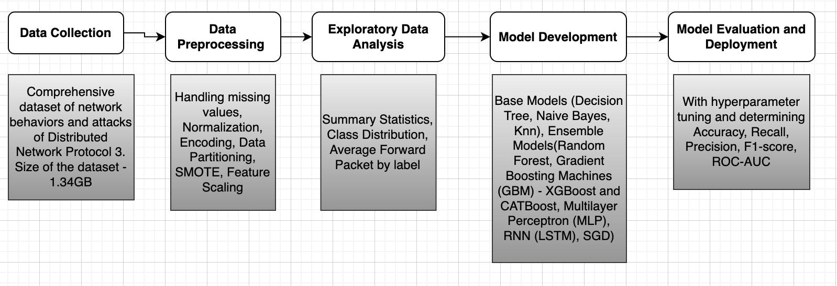
METHODOLOGY

Slide 4



Project Requirements
Google Colab,
Google Drive,
VS Code,
Jupyter Notebook
Language – Python, Pandas, NumPy, Matplotlib, SciPy, scikit-learn,

Slide 5
Data collection
Considering publicly available dataset from ieee-dataport.org which is a comprehensive dataset of network behaviors and attacks of Distributed Network Protocol 3.The dataset is structured following comprehensive frameworks that include a variety of features such as network configuration, traffic data, interaction, and detailed metadata consists of the following
20200514_DNP3_Disable_Unsolicited_Messages_Attack
20200515_DNP3_Cold_Restart_Attack
20200515_DNP3_Warm_Restart_Attack
20200516_DNP3_Enumerate
20200516_DNP3_Ιnfo
20200518_DNP3_MITM_DoS
20200518_DNP3_Replay_Attack
20200519_DNP3_Stop_Application_Attack
Total Dataset size is 1.34 GB.

Slide 6
EXPLORATORY DATA ANALYSIS (EDA)
1. Summary Statistics (mean, median, mode, standard deviation, etc.) for numerical features to
get a sense of the data distribution and class distribution.
2. Identified highly correlated features through heat map.
3. Understood the distribution of total forward packets across different labels.
4. Plotted the distribution of total backward packets across different labels.
5. Plotted the scatter plot of total forward vs total backward packets.
6. Visualized the frequency for each label.
7. Visualized the average number of packets for each label.

Slide 7
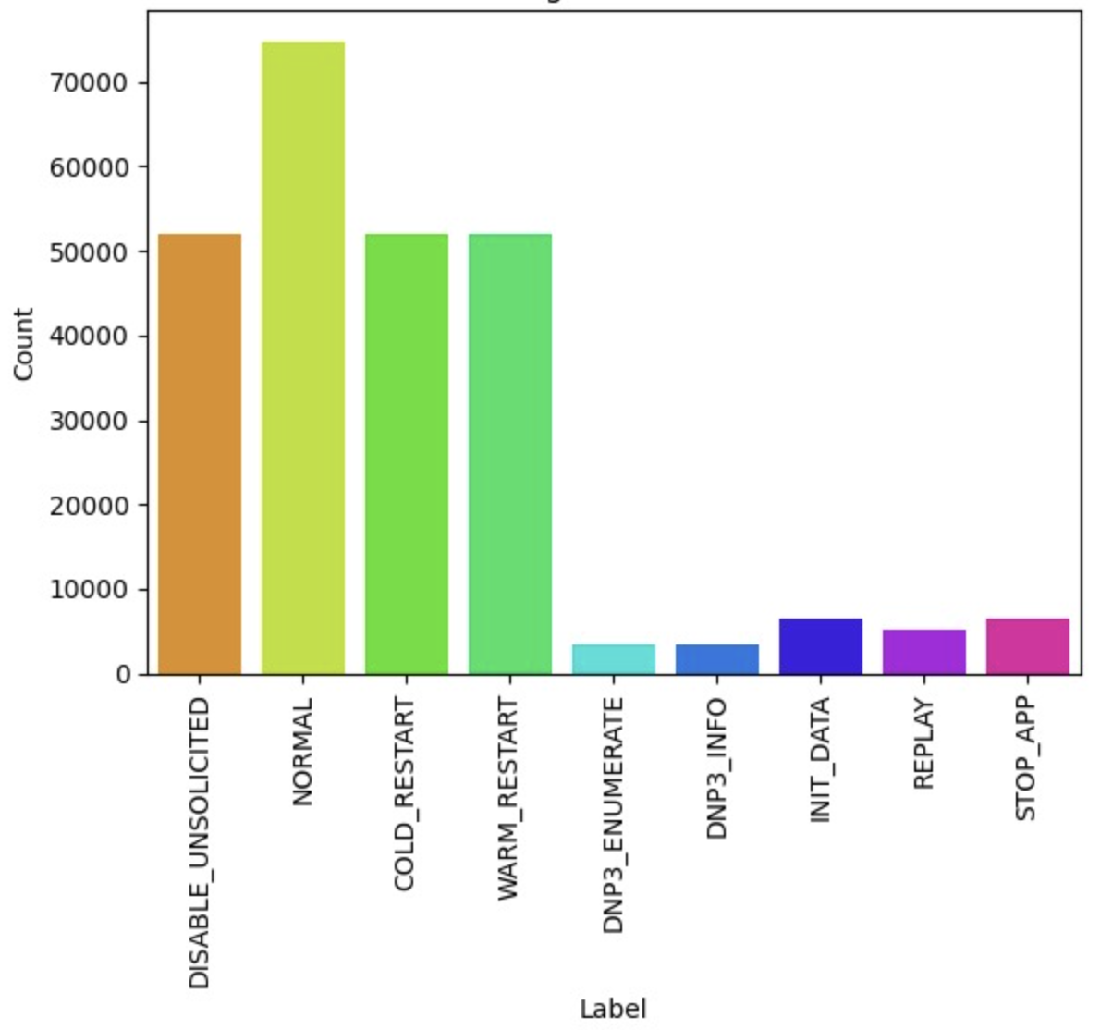
Data Distribution
Disable Unsolicited (Orange): The orange bar indicates a high frequency of events where unsolicited messages are disabled.
Normal (Bright Green): The bar, bright green in color, shows the highest normal operational events.
Cold Restart (Light Green): This bar represents the number of cold restart commands.
Warm Restart (Light Green): Similar in count to Cold Restart, this indicates warm restart commands.
DNP3 Enumerate (Light Green): Slightly shorter than the restart bars, this represents enumeration actions within the DNP3 protocol.
DNP3 Info (Blue): This bar shows informational events related to DNP3 traffic, which are relatively low in count, suggesting these are less common operations or less frequently logged events.
Init Data (Blue): Similar to DNP3 Info, indicating initialization data events.
8. Replay (Purple): Represents events where data or transactions are replayed. This can be a significant security concern as replay attacks can be used to disrupt systems or falsify information.
9. Stop Application (Pink): The bar, in pink, represents commands to stop applications.

Slide 8
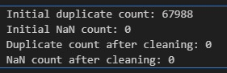
Data preprocessing
Removing duplicates
Removing Nan values
Removing unnecessary contributing features
Flow ID, Source IP, Destination IP, Source Port, Destination Port: These features are identifiers that are unique to each network flow or session. They do not inherently carry predictive information regarding the behavior or characteristics of the network traffic itself but rather relate to specific sessions or connections. Including these in a model might lead to overfitting, where the model learns to recognize specific instances rather than generalizing from the patterns in the data.

Slide 9
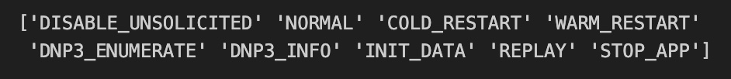
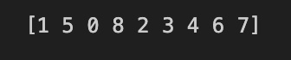
Encoding for Categorical Variable
Feature Scaling using Standard Scaler

Slide 10
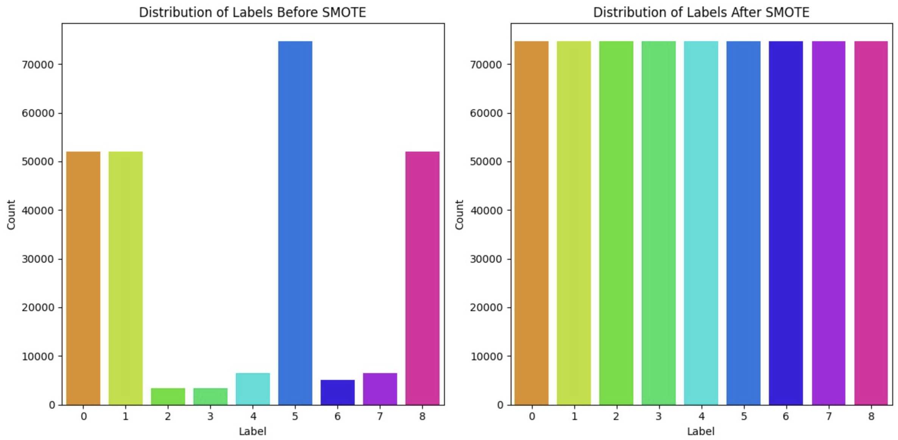
SMOTE for Handling Imbalance Data
Synthetic Minority Oversampling Technique (SMOTE), are explored to rebalance the dataset. SMOTE generates synthetic samples by interpolating between minority class instances and their neighbors.

Slide 11
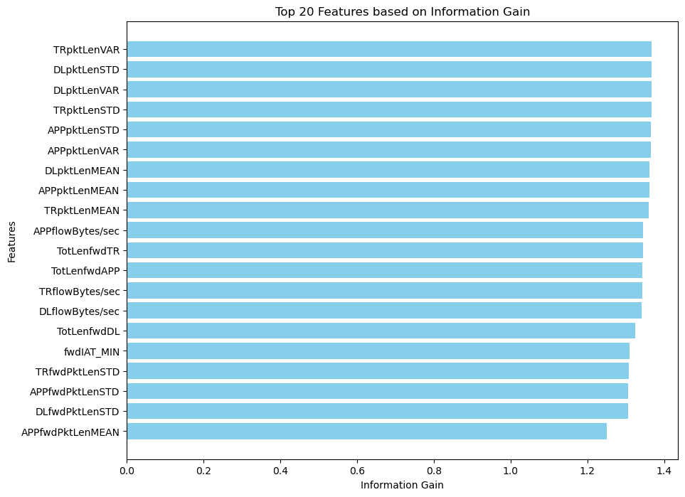
BASE Models
1. DECISION TREE
Decision tree recursively splits the dataset into subsets based on the most significant feature at each node, aiming to maximize the homogeneity of the target variable within each subset.
Decision Trees can easily handle multiple classes, making them suitable for applications like intrusion detection, where each type of attack (e.g., Cold Restart, Disable Unsolicited, Replay, etc.) can be treated as a separate class
Information Gain : Calculated the information gain for each feature to determine its effectiveness in splitting the data. This helps in prioritizing which features are most informative for your Decision Trees

Slide 12
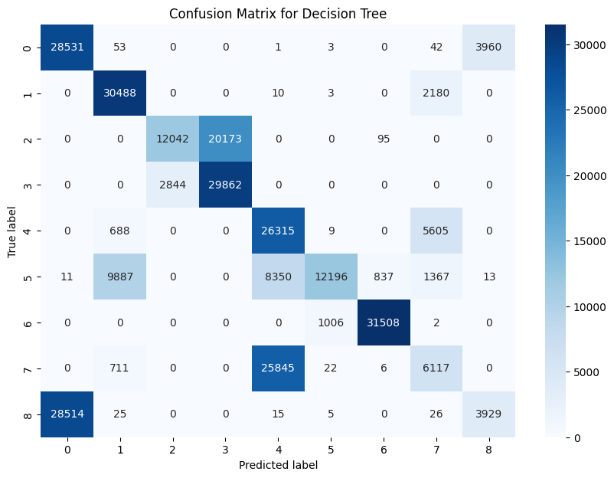
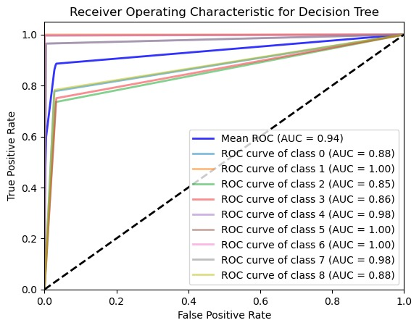
Confusion Matrix and ROC-AUC Curve
.

Slide 13
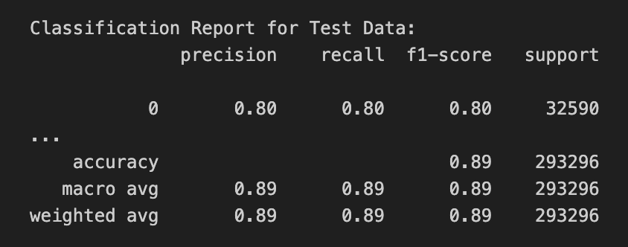
Classification Report for Decision Tree

Slide 14
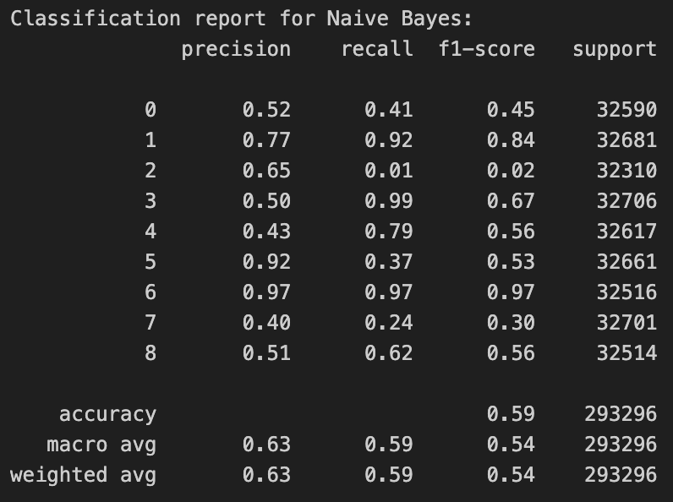
2. Naïve Bayes
Probability-Based Decision Making: Naive Bayes classifiers use a probabilistic approach, making them suitable for scenarios where you need to calculate the likelihood of different types of network intrusions. This is particularly useful in intrusion detection systems where understanding the probability of certain types of attacks can guide response strategies.
Classification Report

Slide 15
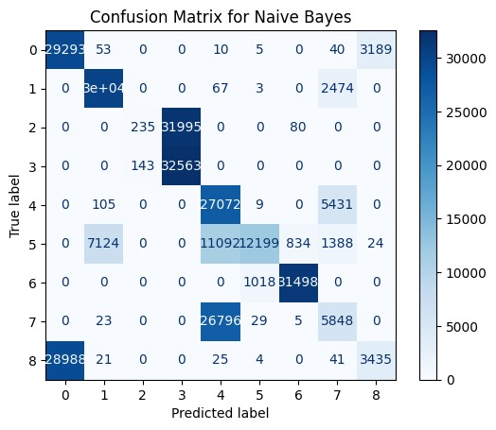
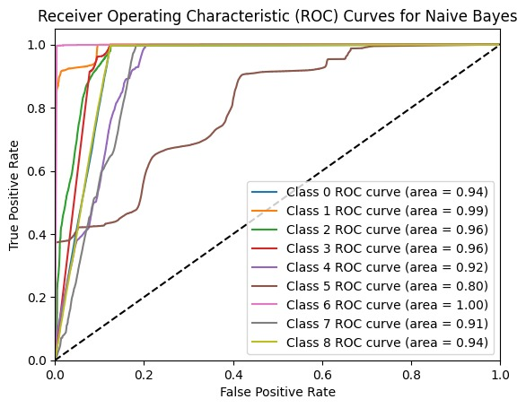
Confusion Matrix and ROC-AUC

Slide 16
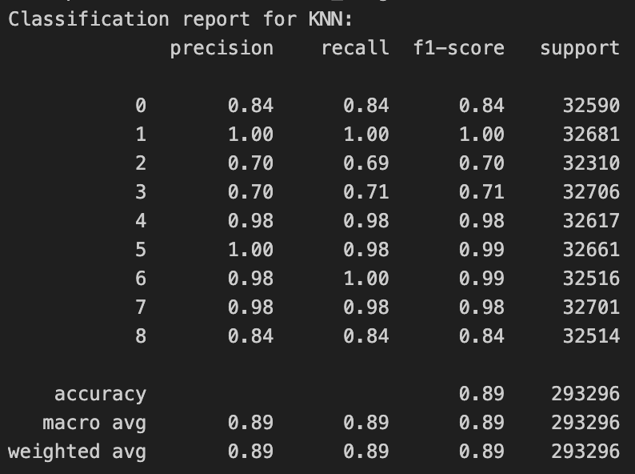
3. K-Nearest Neighbors
Classification Report
KNN evaluates each new network event to be classified based on its similarity to historical events where the context (type of command, frequency, source, etc.). This approach can help quickly flag unusual patterns for further investigation.

Slide 17
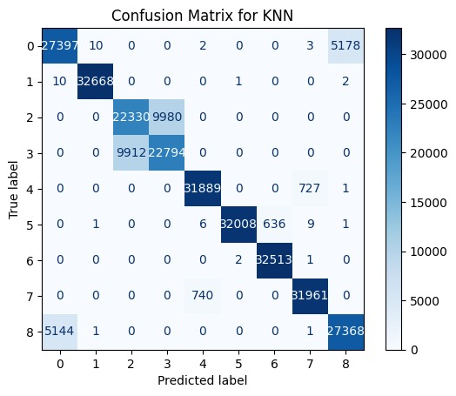
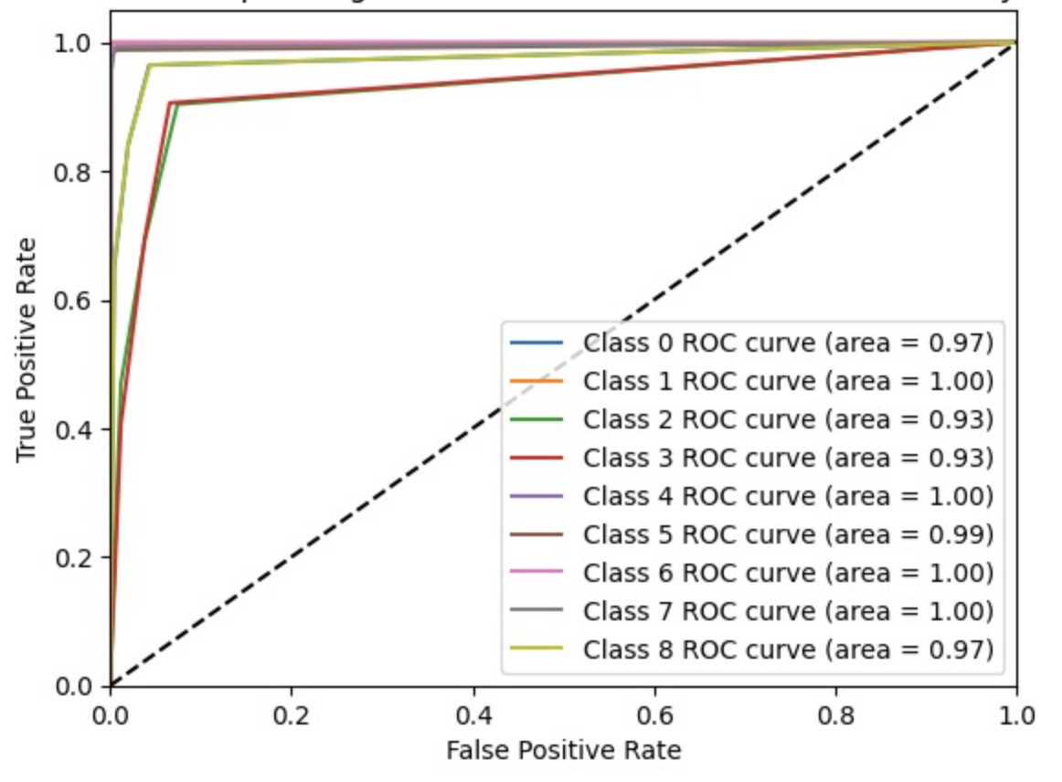
Confusion Matrix and ROC-AUC

Slide 18
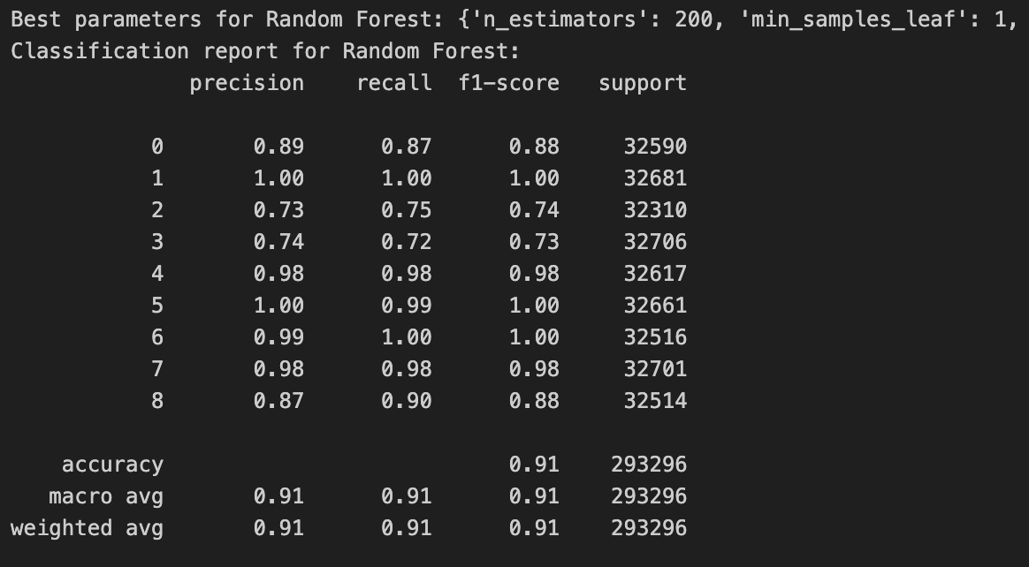
4. RANDOM FOREST
Random Forest is an ensemble learning technique based on multiple decision trees.
It reduces overfitting compared to a single decision tree by averaging the predictions of multiple trees trained on random subsets of the training data and features, resulting in a robust and accurate model.
Random forest provides built-in methods for assessing feature importance, which can help in identifying which network signals or patterns are most indicative of a specific type of attack.
Handling high dimensionality
Improved accuracy
Robustness to overfitting
Classification Report

Slide 19
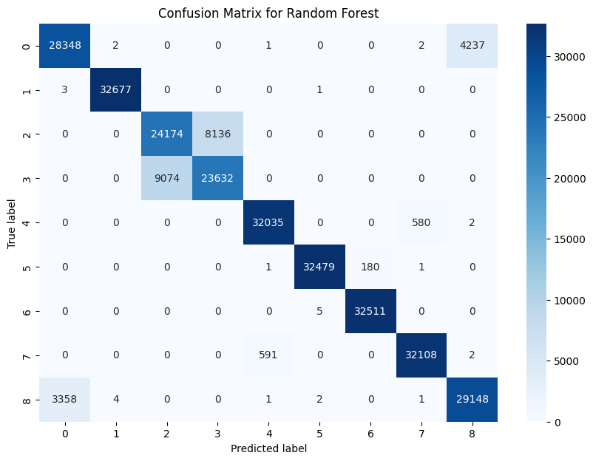
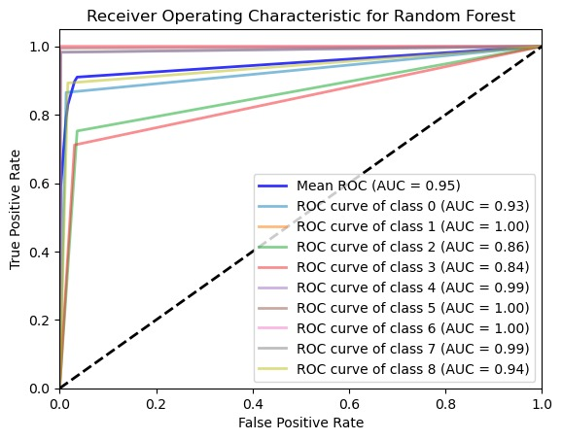
Confusion Matrix and ROC-AUC Curve

Slide 20
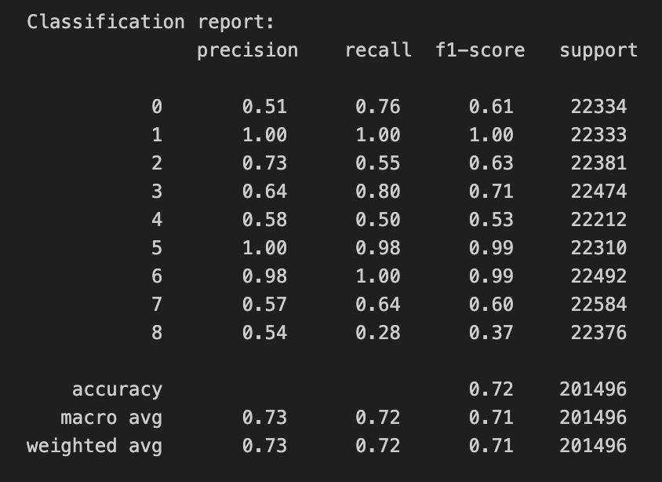
5. Multi layer perceptron (MLP )
Complex Pattern Recognition: MLPs are powerful in recognizing complex and non-linear relationships in data. This capability is essential in intrusion detection, where distinguishing between normal behavior and anomalies can depend on subtle patterns in network traffic
Scalability: MLPs can be scaled up with more data or made deeper with more layers to improve their accuracy and handle large volumes of network traffic, which is typical in modern network environments.
Effective Handling of High-Dimensional Data: Network traffic data often comes in high dimensions, with many features derived from packet captures. MLPs can process these high-dimensional datasets effectively, making them suitable for environments with diverse data types and formats.
Classification Report

Slide 21
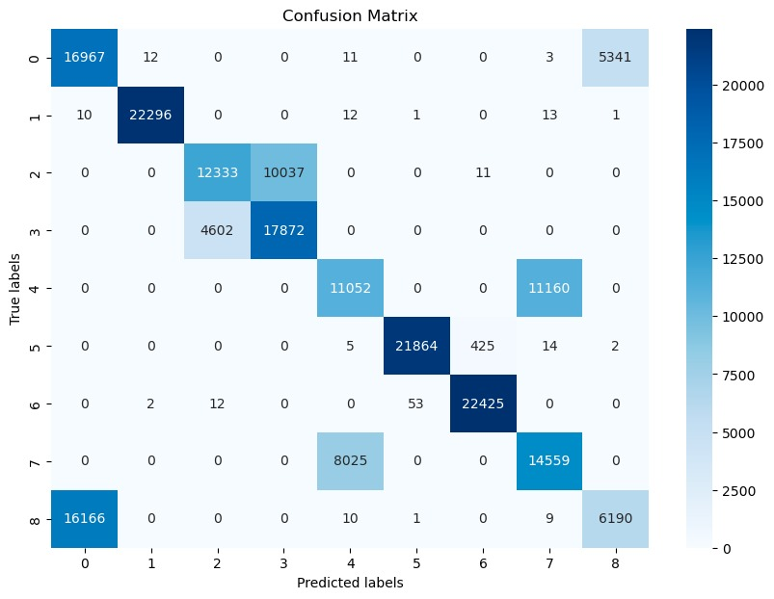
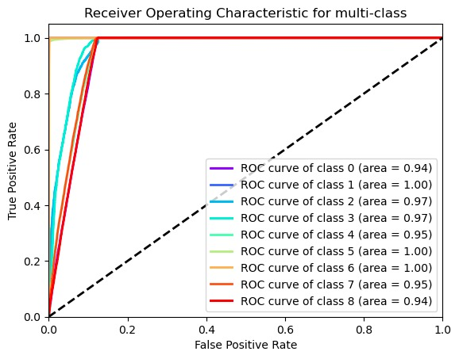
Confusion Matrix and ROC-AUC for Multi Layer Perceptron

Slide 22
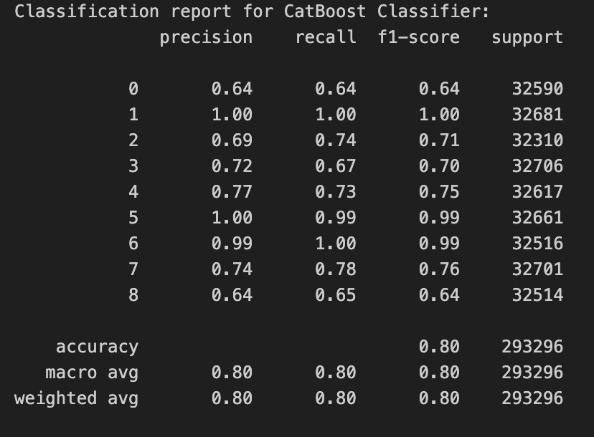
6. Gradient Boosting Machines - CATBoost
High Performance: CatBoost is known for its speed and performance. It is capable of training on large datasets relatively quickly, which is beneficial for handling large volumes of network traffic data in intrusion detection systems.
Robust to Overfitting: CatBoost includes built-in handling of overfitting, which is crucial in a scenario where the model is expected to generalize well from training data to unseen network traffic. It achieves this through systematic ordered boosting, a variation of gradient boosting which is less susceptible to the overfitting problem
Scalable and Flexible: CatBoost can scale to handle large datasets and complex feature interactions. It also provides the flexibility to tune a wide range of hyperparameters to optimize performance, such as learning rate, depth of trees, and l2 regularization.
Classification Report

Slide 23
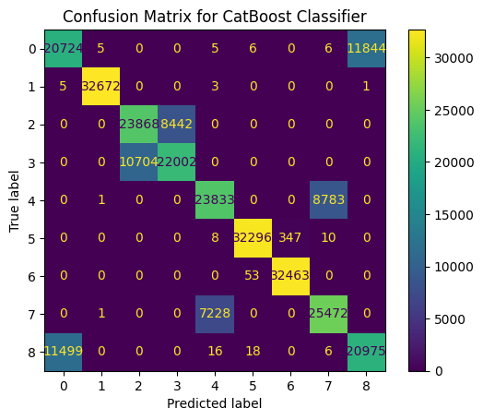
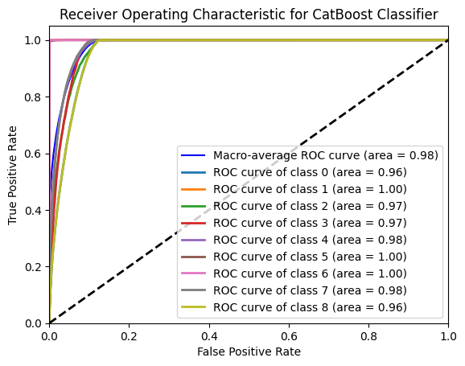
Confusion Matrix and ROC-AUC

Slide 24
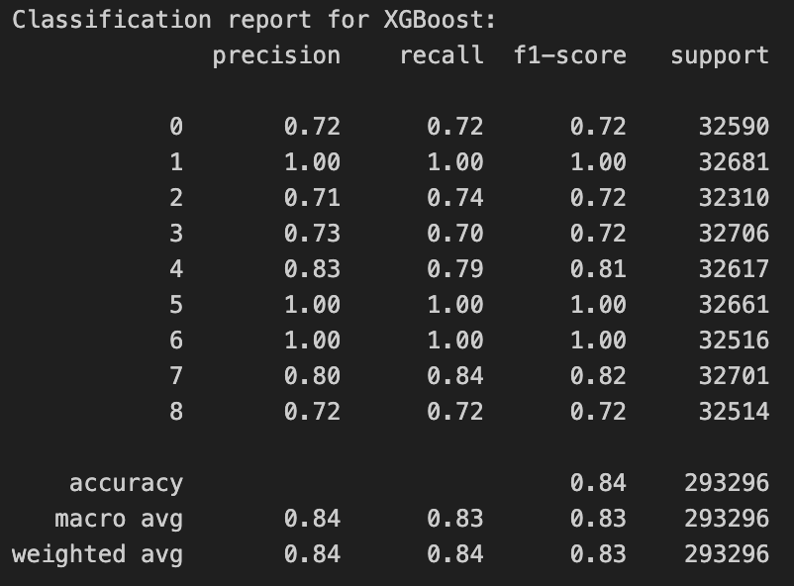
7. Gradient Boosting Machines - XGBoost
XGBoost offers a robust, accurate, and efficient solution for implementing a machine learning-based NIDS in critical infrastructure settings, where high performance and accuracy are essential for protecting against sophisticated attacks. Its ability to manage complex, high-dimensional data and imbalanced classes, combined with powerful model interpretation capabilities, makes it an excellent choice for securing DNP3 environments.
XGBoost provides advanced regularization (L1 & L2), which helps prevent overfitting.
Classification Report

Slide 25
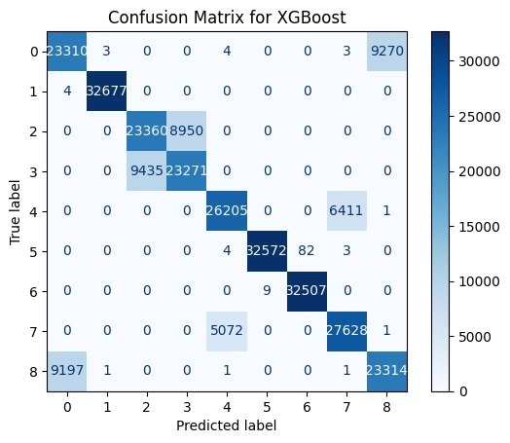
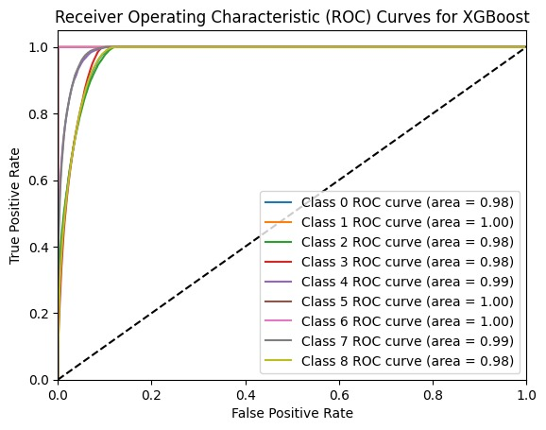
Confusion Matrix and ROC-AUC

Slide 26
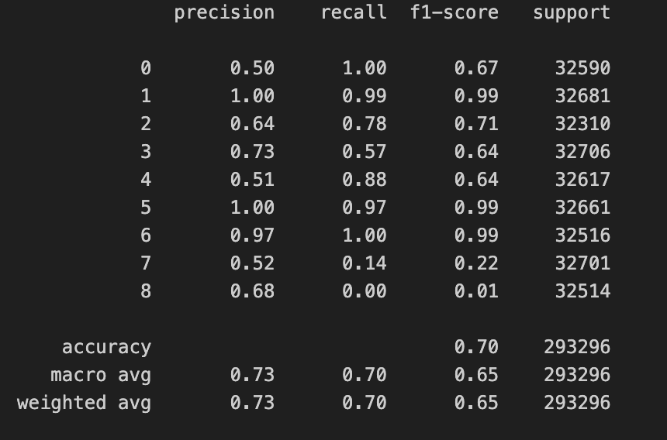
8. Long Short-Term Memory Recurrent Neural Network (LSTM RNN)
Long Short-Term Memory (LSTM) networks, a type of Recurrent Neural Network (RNN), for a machine learning-based Network Intrusion Detection System (NIDS) in environments like DNP3 (Distributed Network Protocol 3) offers distinct advantages, especially considering the sequential nature of network traffic.
Classification Report

Slide 27
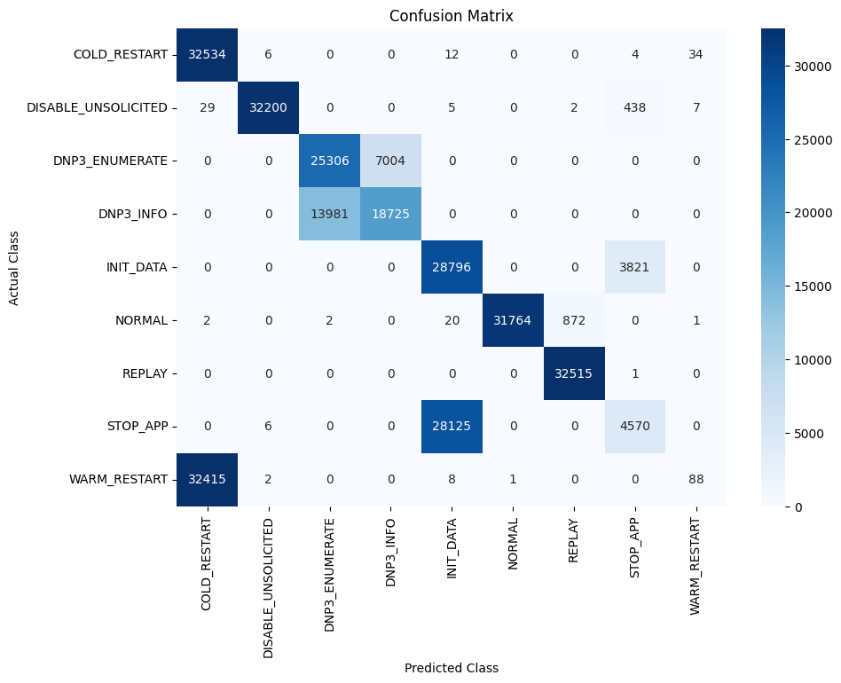
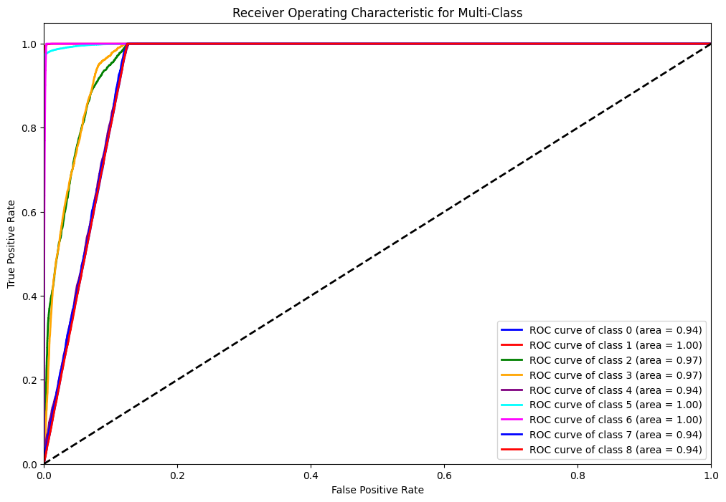
Confusion Matrix and ROC-AUC

Slide 28
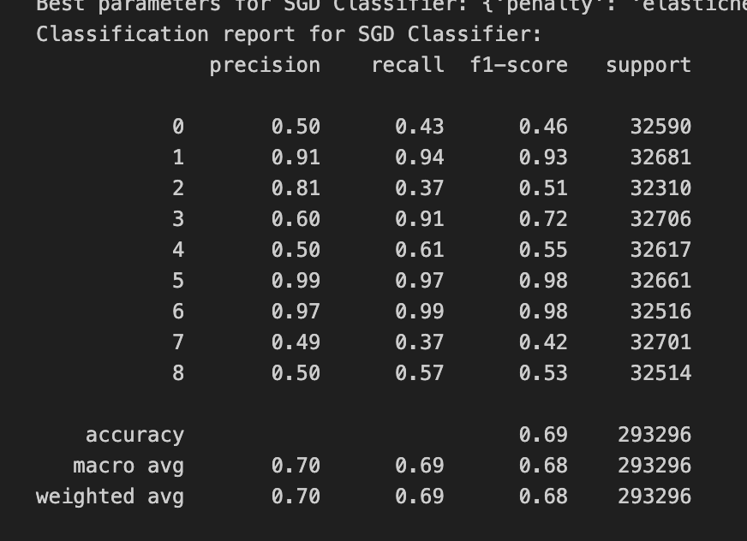
9. Stochastic Gradient Descent (SGD)
Efficiency at Scale
SGD is particularly well-suited for large datasets because it updates the model incrementally using only a subset of the training data at each iteration. This makes it efficient for network intrusion detection systems, where data volumes can be extremely large.
Regularization
SGD provides options for regularization (such as L1 and L2), which help prevent overfitting to the training data. This is particularly important in network security, where the model needs to generalize well from known attacks to potentially unknown ones.
Resource Efficiency
Since SGD requires less memory and computational resources compared to batch methods or complex models like deep neural networks, it can be deployed effectively in environments with limited resources.
Classification Report

Slide 29
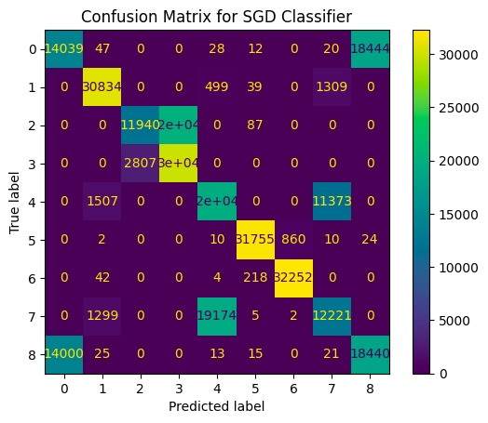
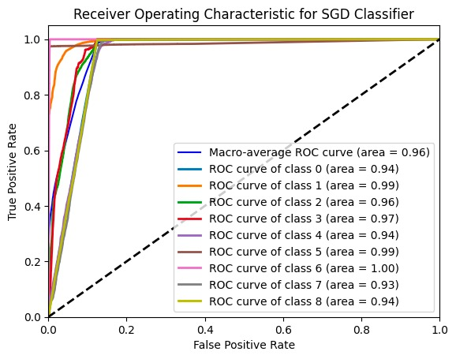
Confusion Matrix and ROC-AUC

Slide 30
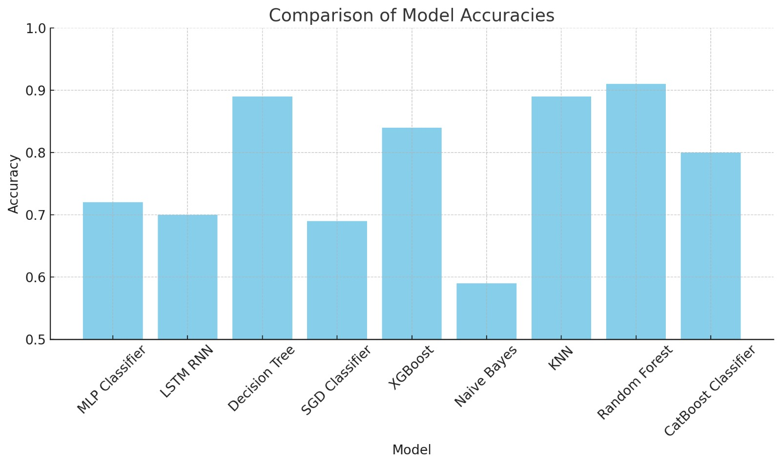
Comparison of model accuracies
Top Performers: Random Forest, KNN, Decision Tree, and XGBoost classifiers show the highest accuracies on the graph, indicating that they are potentially the best models for the given dataset among those tested. These models are known for handling a variety of data types and complexities well, which might contribute to their high performance.
Mid Range Performers: MLP Classifier, LSTM RNN, and CatBoost also show good performance, though slightly lower than the top performers. This suggests that these models are quite effective but might require more tuning or could be less suited to the specifics of the data compared to Random Forest and CatBoost.
Lower Performers: The SGD Classifier, and Naive Bayes, show lower accuracies.

Slide 31
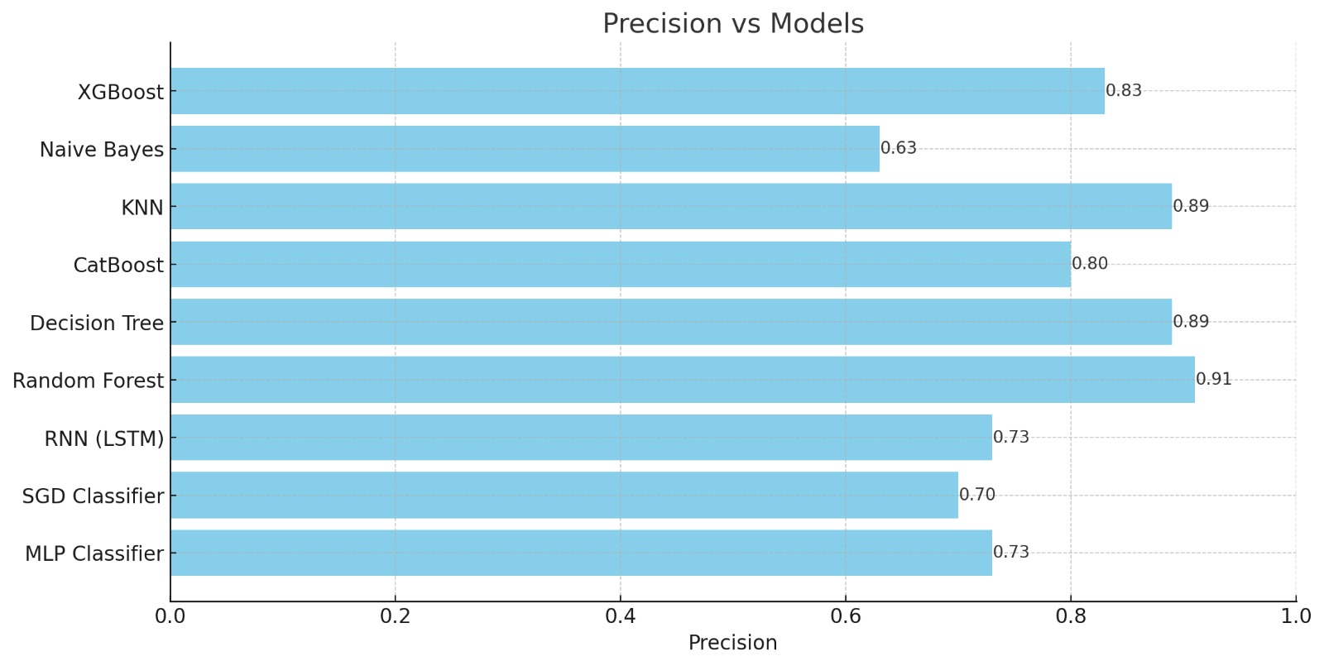
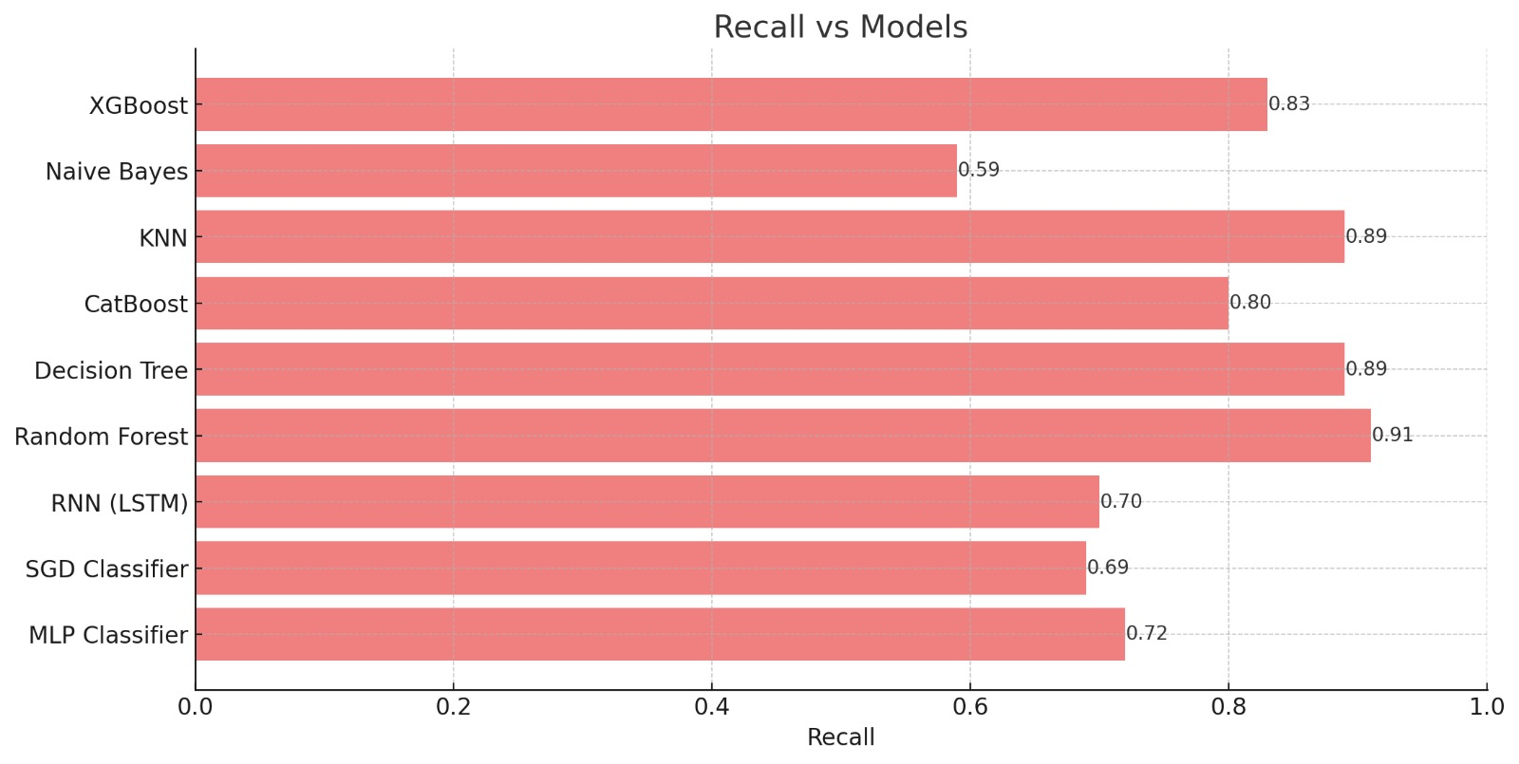
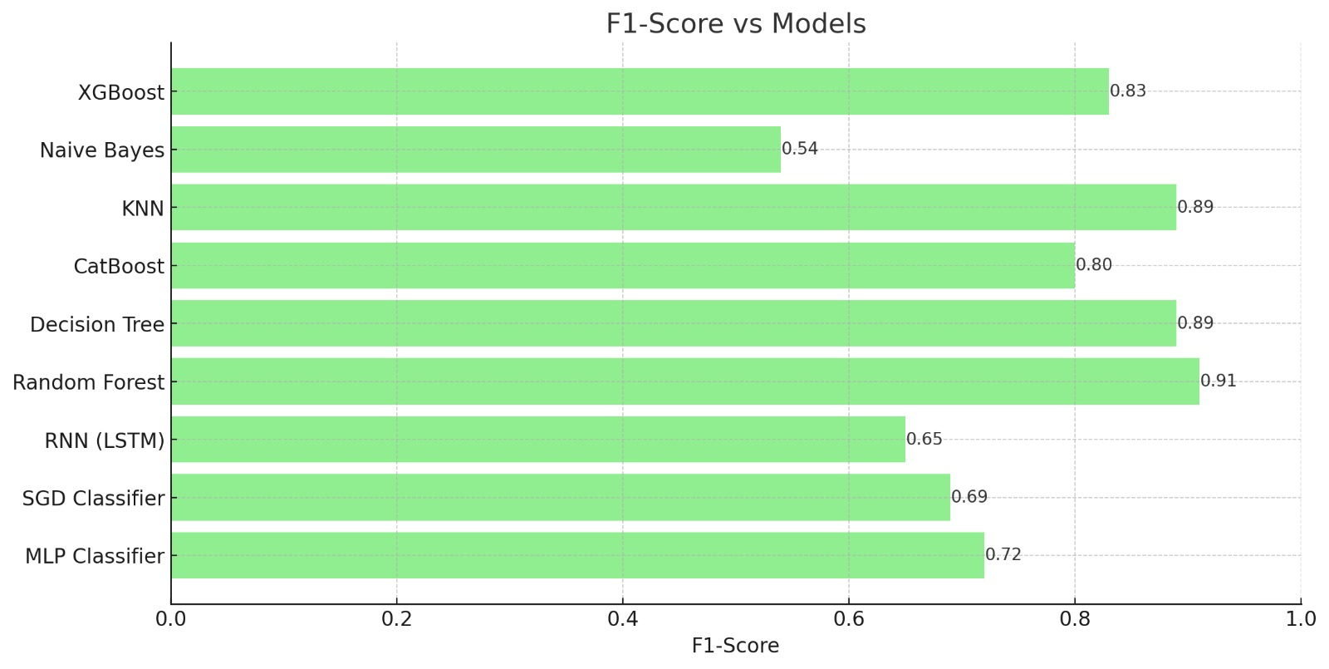

Slide 32
Evaluation Metrics
Confusion Matrix: Visualized the confusion matrix to understand the true positives and false negatives, which is crucial for classification tasks.
Accuracy, Precision, F1-Score, Recall
ROC Curve and AUC: Plotting the ROC curve and calculating the AUC for each class as well as the mean ROC curve gives a comprehensive view of the model performance across classes.
HYPERPARAMETER TUNING
Randomized Search: Defined a hyperparameter grid (GridSearchCV) and used RandomizedSearchCV. This is an efficient way to explore the best parameters.

Slide 33
INNOVATION
Utilized a wide range of machine learning algorithms, such as MLP (Multi-Layer Perceptron), XGBoost, CatBoost, Decision Tree, Naive Bayes, KNN (K-Nearest Neighbors), Random Forest, SDG (Stochastic Gradient Descent), and RNN (Recurrent Neural Network) to predict the various DNP3 attacks with greater accuracies.
Implemented models to achieve adaptability and learning with new data over time to improve their accuracy and relevance as more data is collected.

Slide 34
CONCLUSION
This initiative resulted in a fully functional Intrusion Detection System (IDS) that utilizes machine learning to identify various DNP3 attacks. The system is designed to achieve high accuracy with minimal false positives in detecting different types of network intrusions. It seamlessly integrates into existing network infrastructures to enable real-time monitoring of network traffic. Furthermore, the IDS enhances the security posture of the network by dynamically adapting to new and evolving threats as they arise.

Slide 35
REFERENCES
[1] V. Kelli, P. Radoglou-Grammatikis, T. Lagkas, E. K. Markakis and P. Sarigiannidis, "Risk Analysis of DNP3 Attacks", 2022 IEEE International Conference on Cyber Security and Resilience (CSR), 2022, pp. 351-356, doi: 10.1109/CSR54599.2022.9850291.
[2] V. Kelli et al., "Attacking and Defending DNP3 ICS/SCADA Systems", 2022 18th International Conference on Distributed Computing in Sensor Systems (DCOSS), 2022, pp. 183-190, doi: 10.1109/DCOSS54816.2022.00041.
[3] P. Radoglou-Grammatikis, P. Sarigiannidis, G. Efstathopoulos, P.-A.Karypidis, and A. Sarigiannidis, "Diderot: An intrusion detection and prevention system for dnp3-based scada systems", in Proceedings of the15th International Conference on Availability, Reliability and Security, ser. ARES ’20.New York, NY, USA: Association for Computing Machinery, 2020, doi: 10.1145/3407023.3409314.

Slide 36
THANK YOU!

